Slide 1

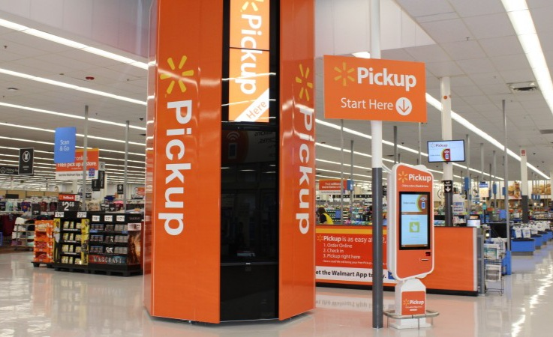
Walmart Online Pickup Orders Machine
By: Alanoud Alzhrani & Ruqaiah Abdullah

Slide 2

Overview:
Introduction
Motivation
Dataset
Data exploration
Tools
Conclusion

Slide 3
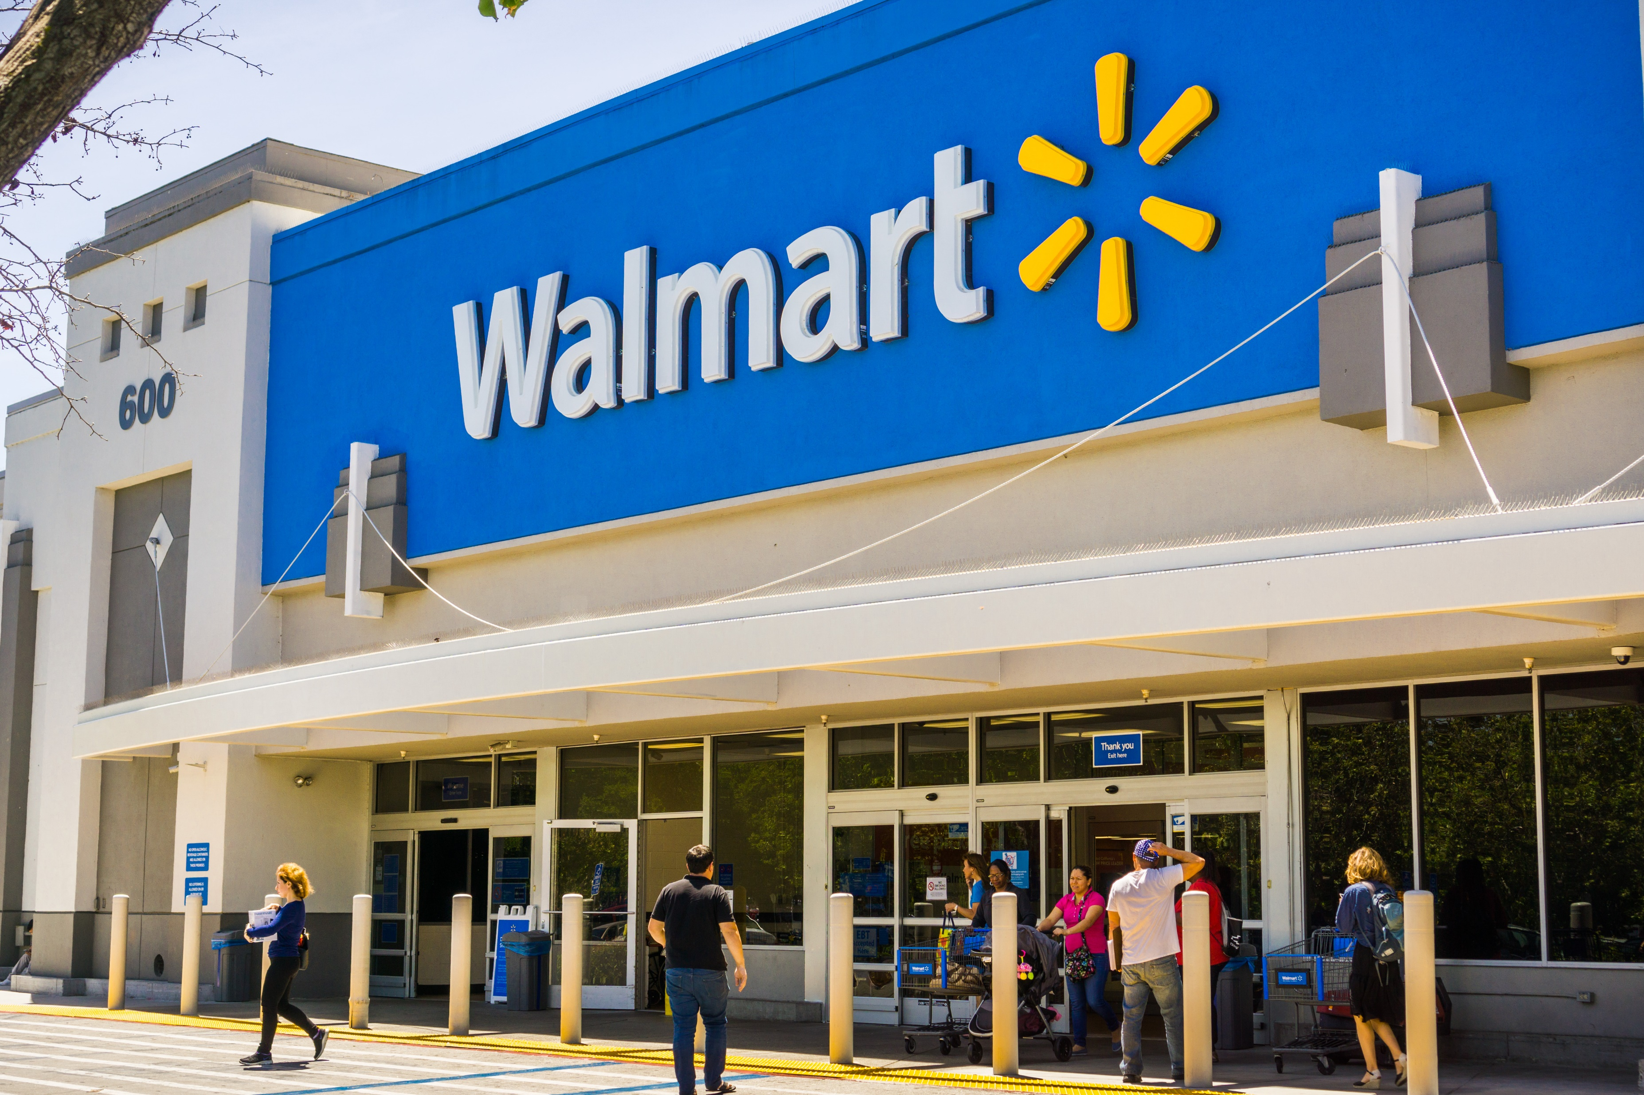
Company background:
Walmart, Inc
American retail corporation:
- hypermarkets
- Discount stores
- Grocery stores
One of the world’s
- biggest retailers
- largest corporations
Founded by Sam Walton in 1962
4,756 Walmart store in the US

Slide 4
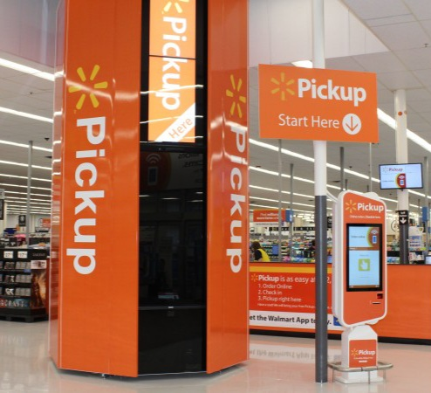

In 2018,
Walmart launched a giant vending machine for online pickup orders.
Arrange a shipment ahead of time
Visit the store
Access order via a barcode scanner

Slide 5

Motivation:
Planning to expand business and reach out to more costumers.
By analyzing the sales dataset:
- most crawdad stores
- suitable stores for the pickup machine

Slide 6
Dataset:
45 stores
Description | Data
the Store number | Store
the week of sales | Date
sales for the given store | Weekly Sales
whether the week is a special holiday week 1 – Holiday week 0 – Non-holiday week | Holiday Flag
Temperature on the day of sale | Temperature
Cost of fuel in the region | Fuel Price
Prevailing consumer price index | CPI
Prevailing unemployment rate | Unemployment

Slide 7

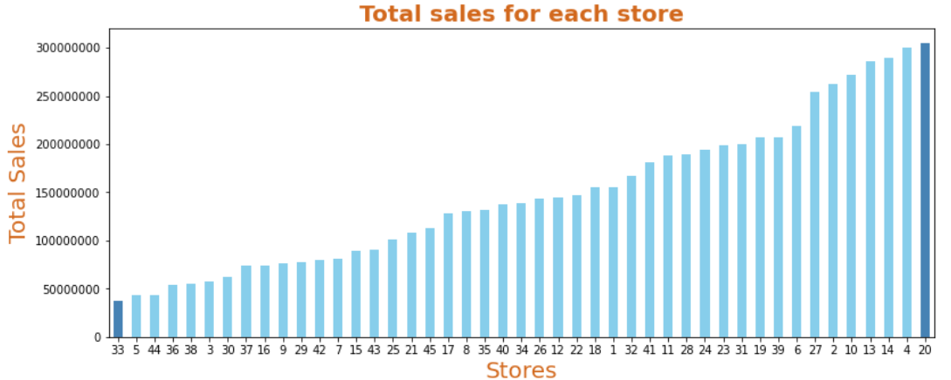
Highest/Lowest stores:
Data exploration:
05

Slide 8
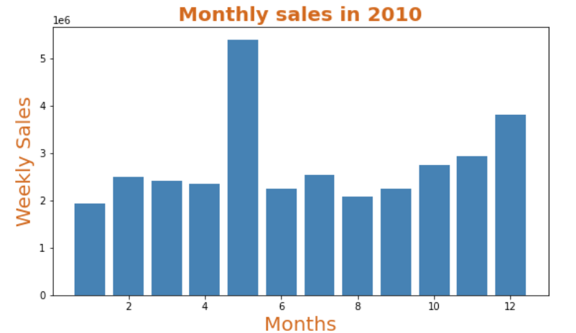
Monthly sales for each year (2010-2011-2012)
05

Slide 9
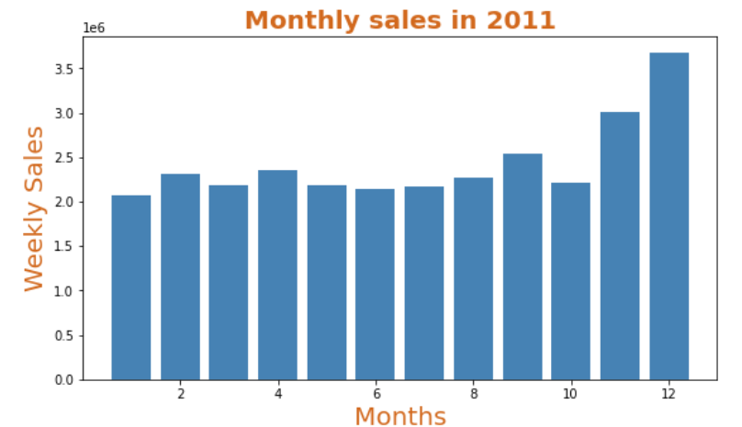
Monthly sales for each year (2010-2011-2012)
05

Slide 10
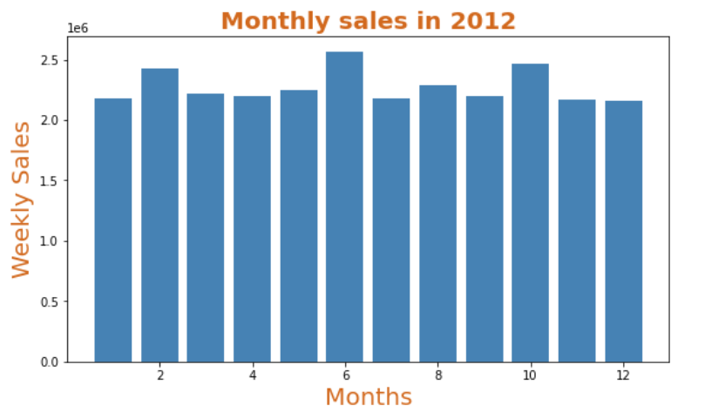
Monthly sales for each year (2010-2011-2012)
05

Slide 11

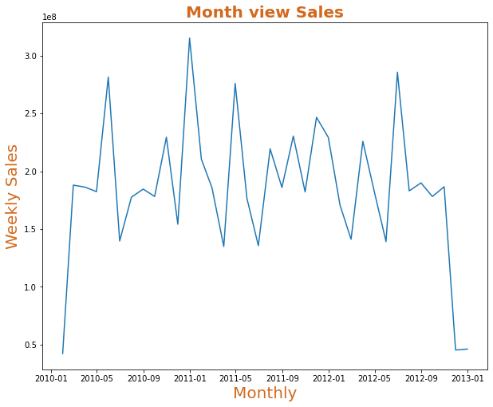
08

Slide 12
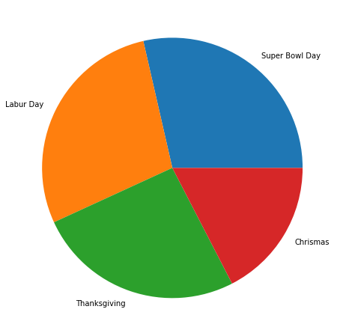
Some holidays have a negative impact on sales, which holidays have highest/lowest sales?
08

Slide 13

Tools:
Python programming language .
Jupyter lab as programming environment.
Numpy seaborn ,and Pandas for data manipulation.
scipy and math for mathematical operations.
PowerPoint for presentation.
14

Slide 14
Conclusion
Highest and lowest stores.
Store with maximum sales / minimum sales.
created new columns (day, month, year)
-To find out the monthly sales for each year.
Holidays have highest/lowest sales.
15

Slide 15


